Slide 1
Data Structures
with
C++
Lecture#13 Postfix Evaluation

Slide 2
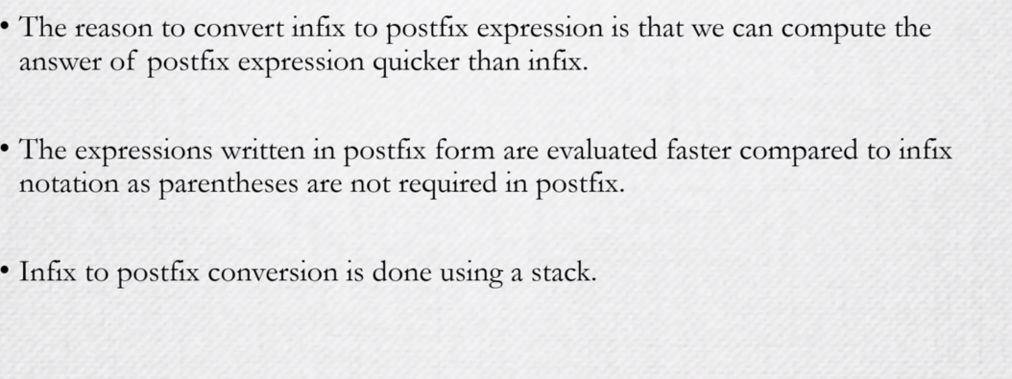
Postfix Evaluation

Slide 3
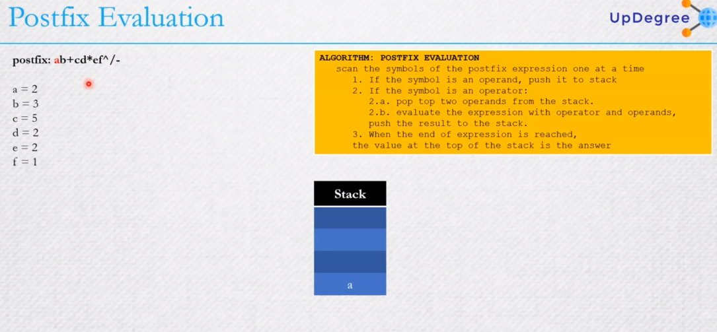
Infix\postfix Expressions

Slide 4
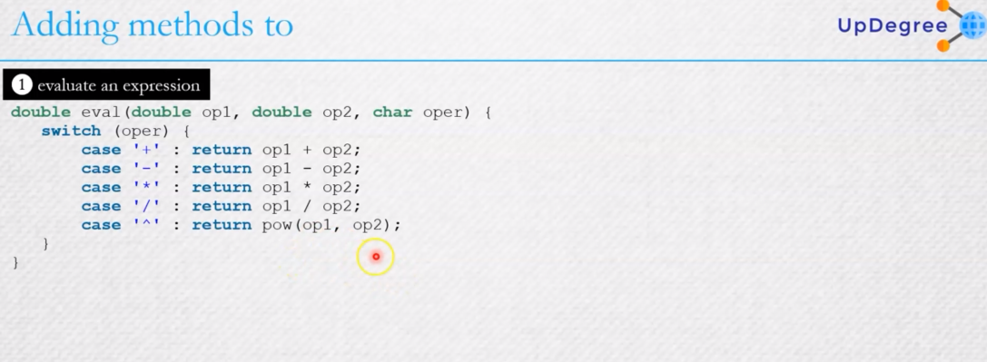
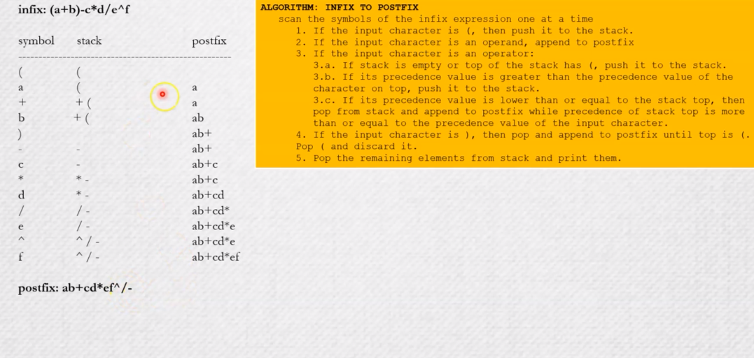
Infix to postfix conversion

Slide 5
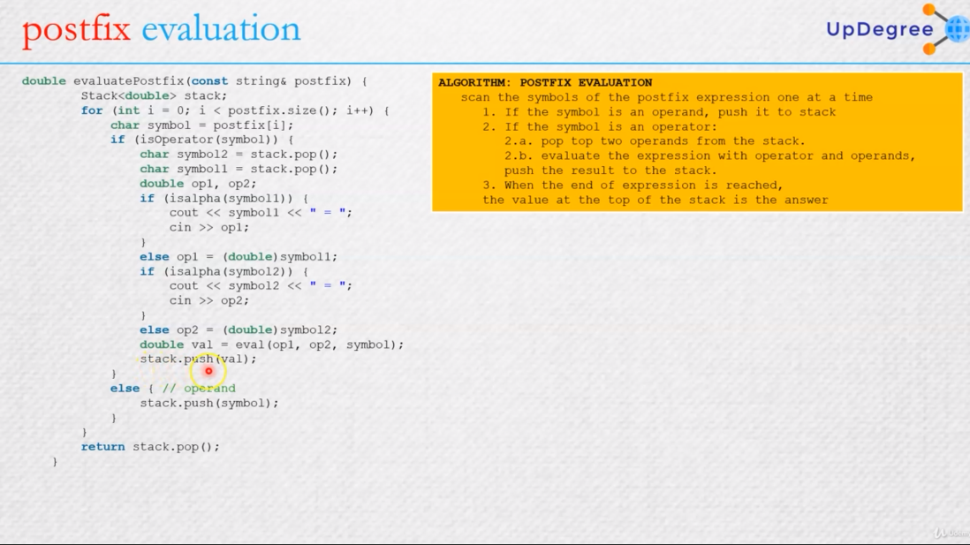
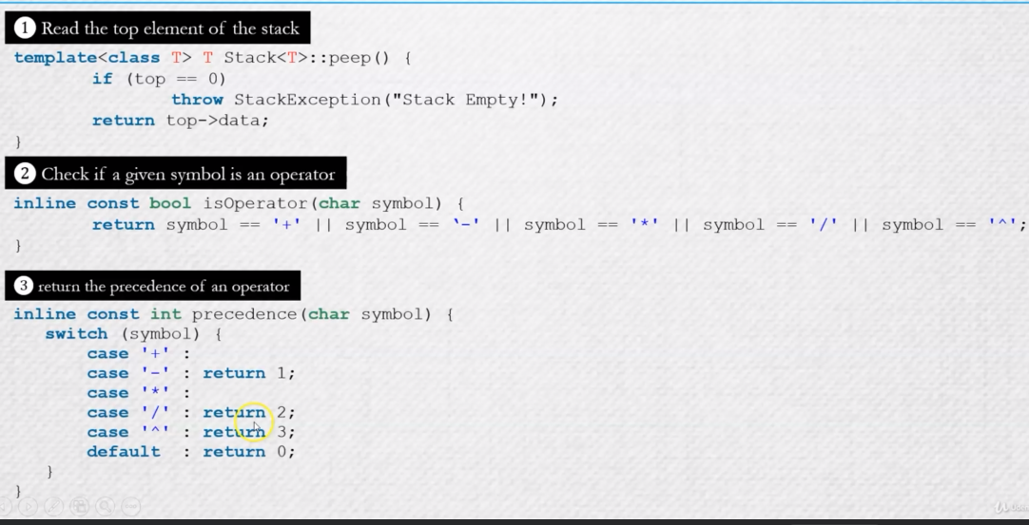
Adding methods
n
data
next
0
top

Slide 6
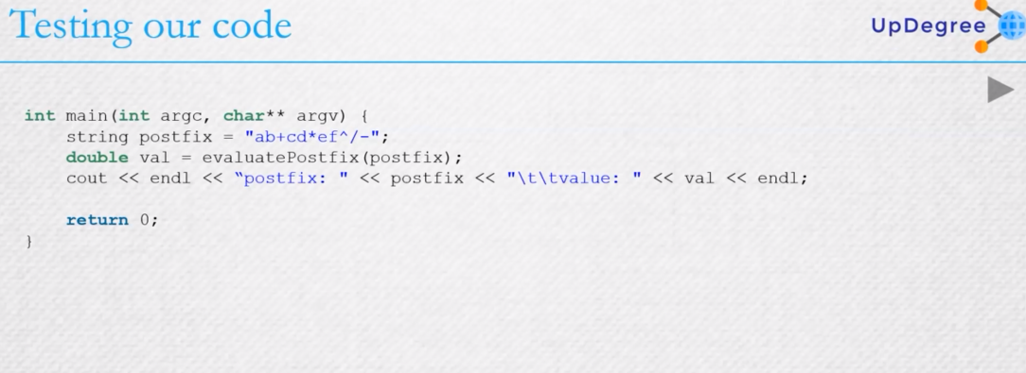
implementation

Slide 7


